Slide 1
Profile of SAROND Welding s.r.o.
Sarond Welding s.r.is a manufacturing company focused on supplies for the energy, traffic and pharmaceutical engineering. The company management consists of people with 20 years of experience in the engineering industry.
We manufacture or secure the manufacturing of weldments of different sizes. We are able to produce weldments according to the customer's drawings or according to the documentation designed in our design department. We are able to supply a piece and mainly serial production steel weldments in grades 11 to 17 including their further processing or final surface treatment or coating, painting to packaging as required.
Weldments are of typical weights from 50 up to 5,000 kg.
We use the MIGATRONIC automated portal welding robot for serial production of metal components, which produces welds of the highest quality. Welding method of MIG/MAG /TIG/ plasma.
Welding is performed according to EN 3834-2 and ČSN 732601 under the supervision of a qualified welding engineer.
All risks arising from the company’s production activity, including in relation to foreign supplies, are secured by a contract with the renowned brokerage company - RENOMIA a.s.

Slide 2
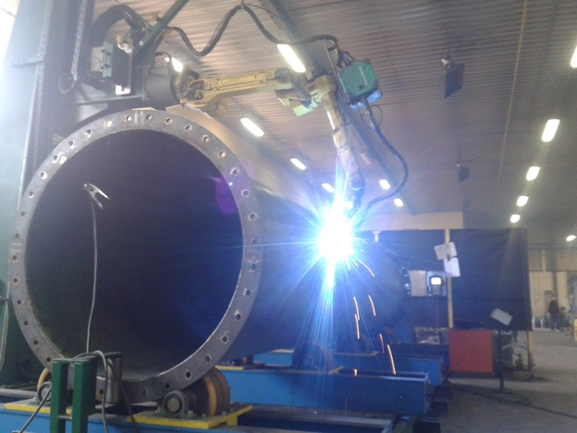
Steel weldments
Robotic welding from small batches or ordering dozens of pieces. If you repeatedly need sub-groups welded for your final products and you do not want to invest in automation, we are the perfect choice for you.
For series production, we use an automated MIGATRONIC welding robot that produces the highest quality welds. Migatronic MIG/MAG/TIG/ PLASMA welding robot Maximum length: 9,000 mm, Maximum height: 3,200 mm, Maximum width: 3,200 mm
We also supply complex form piece steel welding, robotically or manually welded. Economically and qualitatively, it’s very advantageous to perform long welds with a robot on piece weldments.
All welding is performed according to EN 3834-2 and ČSN 732601 under the supervision of a qualified welding engineer.
Drawing (project) documentation can be yours or we offer our own design capacity. Including 3D models (SolidWorks), product design and so on.
Sheet metal bends and cut-outs up to 20 mm thickness for final weldments are provided on our own machines.
We can also produce other types of welded constructions according to the customer’s requirements, from standard structural steels S235, S275, S355 and WELDOX 420, 460, 700 or HARDOX 400, 450, 500 abrasion resistant steel grades. Stainless steel material in the quality of 1.4301 - 1.4307 - 1.4404 - 1.4541 - 1.4571 - 1.4828 - 1.4841.
Modern manufacturing and trading company
Wealth of experience in the field of supplies to the engineering industry
Quality products and services
The company builds on market knowledge and the experience of its employees

Slide 3
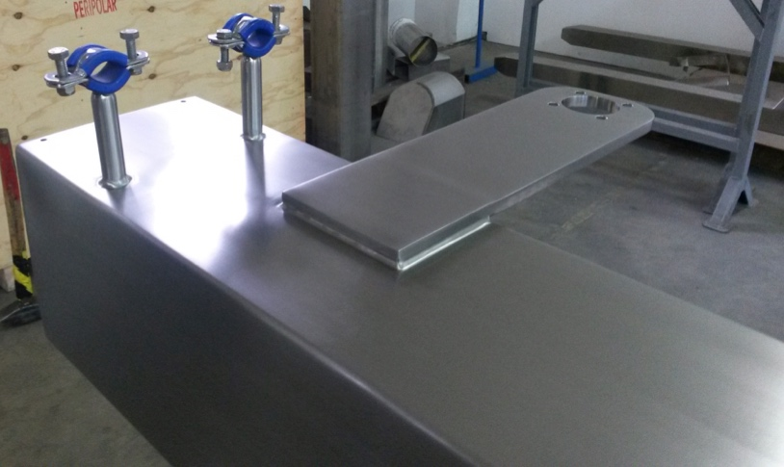
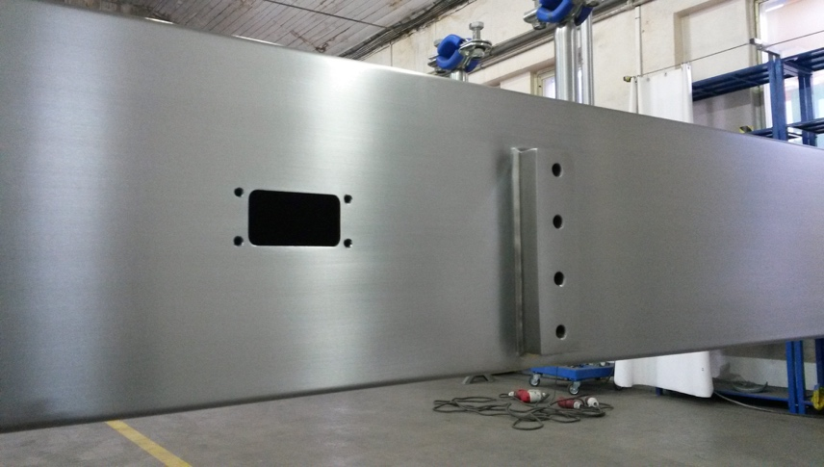
Stainless material surface treatment
Manual material surface sanding from Ra 0.1 according to customer requirements including surface roughness certificate.
Modern manufacturing and trading company
Wealth of experience in the field of supplies to the engineering industry
Quality products and services
The company builds on market knowledge and the experience of its employees

Slide 4
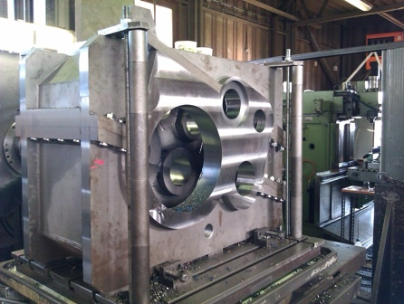
Other services
We are able to supply all weldments and cut-outs, including their further processing, finishing, varnished surface and packaging as required.
Material testing of sheets, cut-outs, weldments according to the required specification and assessments.
Development of measuring reports and products are provided with stamps.
Passivation of welds after welding.
Ra meter - to measure the material’s required surface roughness.
Securing additional tests according to customer needs through an independent laboratory.
Modern manufacturing and trading company
Wealth of experience in the field of supplies to the engineering industry
Quality products and services
The company builds on market knowledge and the experience of its employees

Slide 5
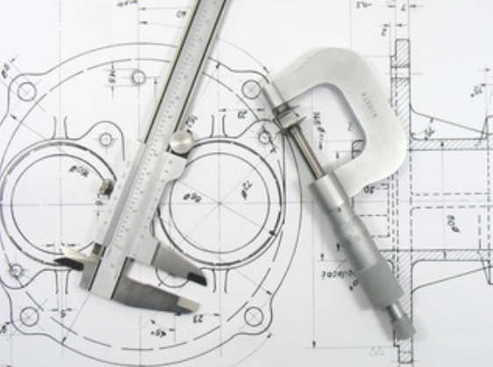
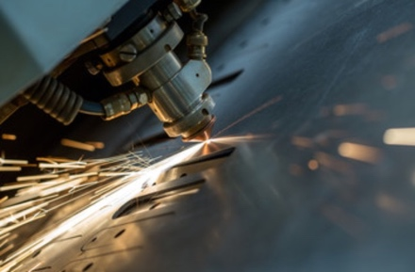
Production options
Design work
Design work is carried out in co-operation with the design office, which works with the current versions of the SOLIDWORKS and INVENTOR 3D CAD programmes. These programs allow output in native formats of these CADS or convert them to DWG, DXF, IGES and more. They meet the requirements for spatial visualisation of drawn products and enable the creation of 2D documentation needed for production.
Material division
We use the following to prepare and divide the material:
Band saw – profile cutting with the PILOUS ARG 300 Standard band saw - cut to a diameter 300mm.
Laser beam – we use the Trumpf laser for sheet metal cutting - table size 1500x3000mm. Cutting of structural steel to a thickness of 20mm and stainless steel to a thickness of 12mm.
Water beam – we use it for dimensioning bigger pieces - table size 3000x6000mm. The strength of the material ranges from 0.5mm to 220mm. Ability to cut at an angle. An advantage is a cold cut that doesn’t influence the cut material thermally.
Modern manufacturing and trading company
Wealth of experience in the field of supplies to the engineering industry
Quality products and services
The company builds on market knowledge and the experience of its employees
Bending the material
Bending press – material bends are performed on the SAFAN E-BRAKE 100-3100 bending press with a maximum pressing pressure of 1000 kN and a maximum bending length of 3100 mm.

Slide 6
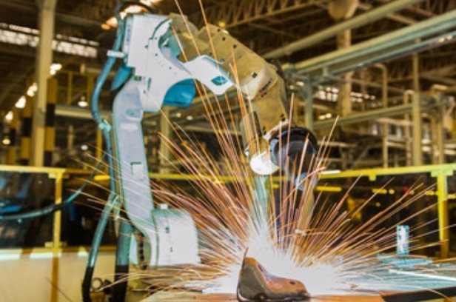
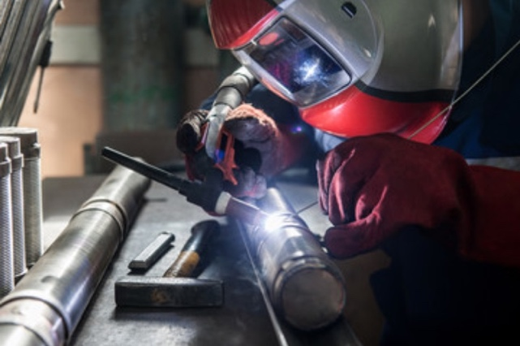
Production options
Manual and robotic welding
According to customer requirements, we are able to produce weldments from S235, S275, S355 standard structural steels, WELDOX 420, 460, 700 and HARDOX 400, 450, 500 abrasion resistant steels. Stainless steel quality material 1.4301 - 1.4307 - 1.4404 - 1.4541 - 1.4571 - 1.4828 - 1.4841. For the production of weldments, we only use standard certified welders for MIG, MAG and TIG welding methods. All welding is performed according to EN 3834-2 and ČSN 732601.
For serial production, we use a FANUC automated welding robot with MIGATRONIC fittings, which produces welds of the highest quality. Migatronic MIG/MAG/TIG/PLASMA welding robot Maximum length: 9,000 mm, Maximum height: 3,200 mm, Maximum width: 3,200 mm.
Welding engineer
We use a certified welding engineer with several years of experience in the welding field - Certified EWE (CWS ANB).
Modern manufacturing and trading company
Wealth of experience in the field of supplies to the engineering industry
Quality products and services
The company builds on market knowledge and the experience of its employees

Slide 7
Production options
Working
At the request of the customer, we are able to co-operate with CNC machining and portal centres machining up to 10,000 mm.
Surface treatments
Grinding of stainless materials
We specialise in manual grinding, brushing and polishing stainless steel materials according to customer requirements from Ra 0.1 μm. Grinding is provided by qualified grinders with several years of experience in the industry. Grinding stainless materials is provided especially for the pharmaceutical, food and furniture industries, where high emphasis is placed on the quality of the polished surface.
Varnishing
We are able to provide both wet as well as powder varnishing with pre-treatment of the material by blasting. Paints according to customer requirements - International, Hempel, etc.
Metallisation
Application of metal coatings by hot-dip coating - is intended for the material’s surface protection from corrosion.
Zinc plating
We have the ability to provide galvanic and hot dip galvanizing for finished products.
Modern manufacturing and trading company
Wealth of experience in the field of supplies to the engineering industry
Quality products and services
The company builds on market knowledge and the experience of its employees

Slide 8
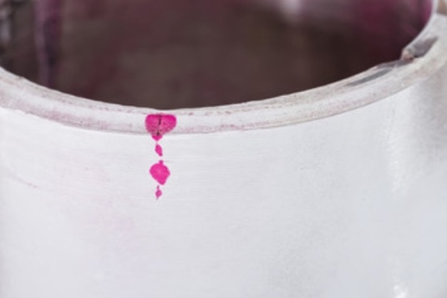
Production options
Test
We can secure additional testing according to the customer's needs through an independent laboratory:
PT - Penetrant Testing – Capillary testing is one of the most widespread non-destructive testing methods (NDT). Suitable for detection of surface defects.
MT – Magnetic Particle Testing – MT is the most widely used method of non-destructive testing of the material due to its relative simplicity and ease of execution.
UT – Ultrasonic Testing – Ultrasound is one of the basic non-destructive testing methods. It allows detection of the presence of internal defects in the material.
RT – Radiographic Testing - Radiography allows you to obtain a permanent image of a material’s internal defects, particularly in the inspection of welds and castings.
VT – Visual Testing – The method is focused on the detection and evaluation of surface conditions
Technical inspection
A thorough initial check is a matter of course for us, in which we try to prevent scrapes at the very beginning of the production process and subsequent final inspection of the final product before delivery to the customer.
Modern manufacturing and trading company
Wealth of experience in the field of supplies to the engineering industry
Quality products and services
The company builds on market knowledge and the experience of its employees

Slide 9
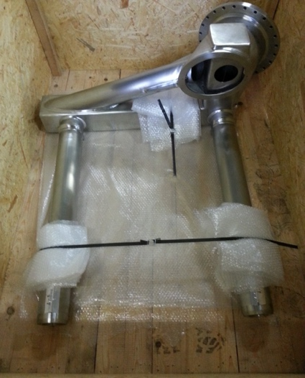
Production options
Packaging
Packaging of finished products is designed to bring the final product to the customer without any defects or damage that may be caused by transport. Especially in international deliveries where the product is transported over a longer distance.
Logistics
We use our own shipping up to 2 tons for national transport. For international supplies, we use the services of large logistics companies such as DHL, UPS and SGM.
Modern manufacturing and trading company
Wealth of experience in the field of supplies to the engineering industry
Quality products and services
The company builds on market knowledge and the experience of its employees

Slide 10
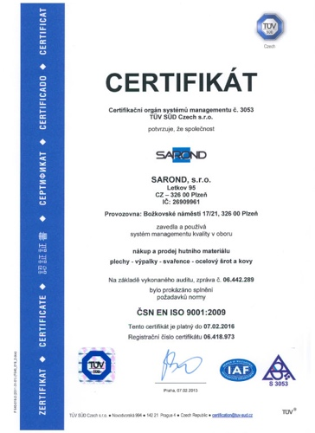
Company headquarters::
Plzeň – Božkovské náměstí 17/21,Plzeň GPS: 49°43'56.436"N, 13°25.'21.219"E
Production, Warehouses
Plzeň – Božkov, K potoku ,Plzeň
The aim of successful supply is to provide transport to the customer on time, in the required quality and within INCOTERMS. In this respect, we use the services of contracting carriers and forwarders. Our major partner is a logistics company with the largest transport network in Europe. Orders are shipped according to customer requirements. Goods is packaged, placed on pallets and strapped as required.
Financing
SAROND WELDING, s.r.o. uses the services and products of ČSOB, a.s. to secure efficient trade financing.
Bank: ČSOB. a.s.
CZK – 264 418 822/0300
EUR – 264 419 366/0300
Insurance
SAROND WELDING, s.r.o. carries out insurance for domestic and foreign trade through RENOMIA, a.s.
Product liability insurance is valid up to the amount of CZK 20 million.
Modern manufacturing and trading company
Wealth of experience in the field of supplies to the engineering industry
Quality products and services
The company builds on market knowledge and the experience of its employees

Slide 11
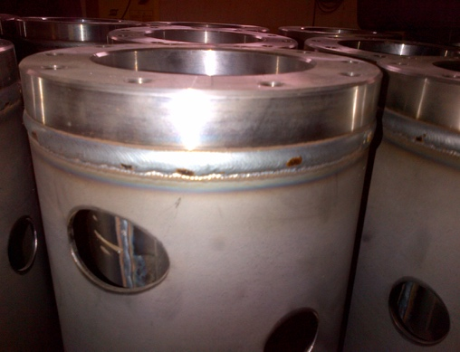
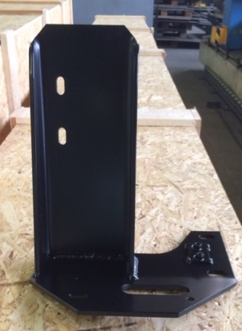
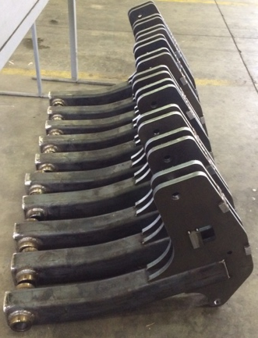
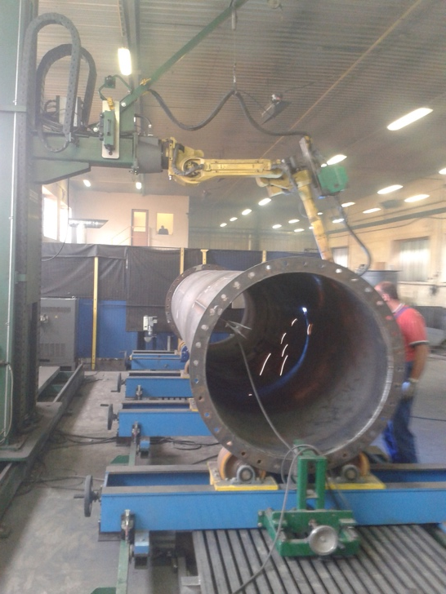
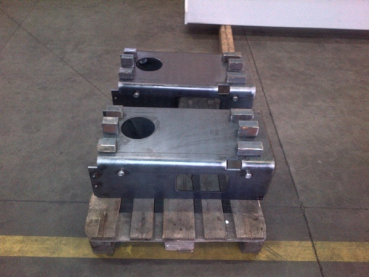
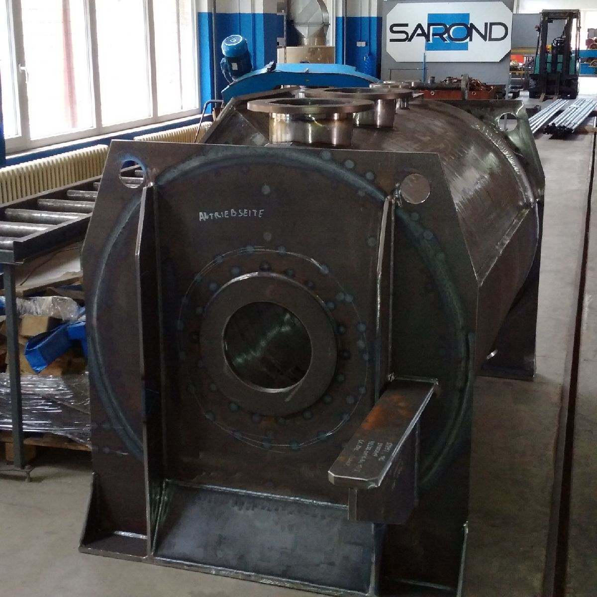
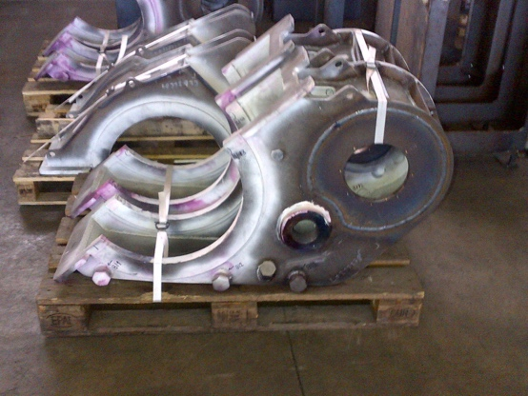
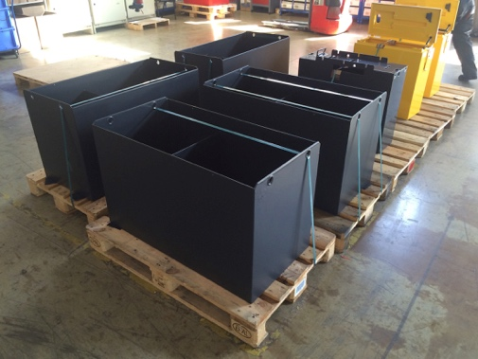
Reference - black warehouse hall

Slide 12
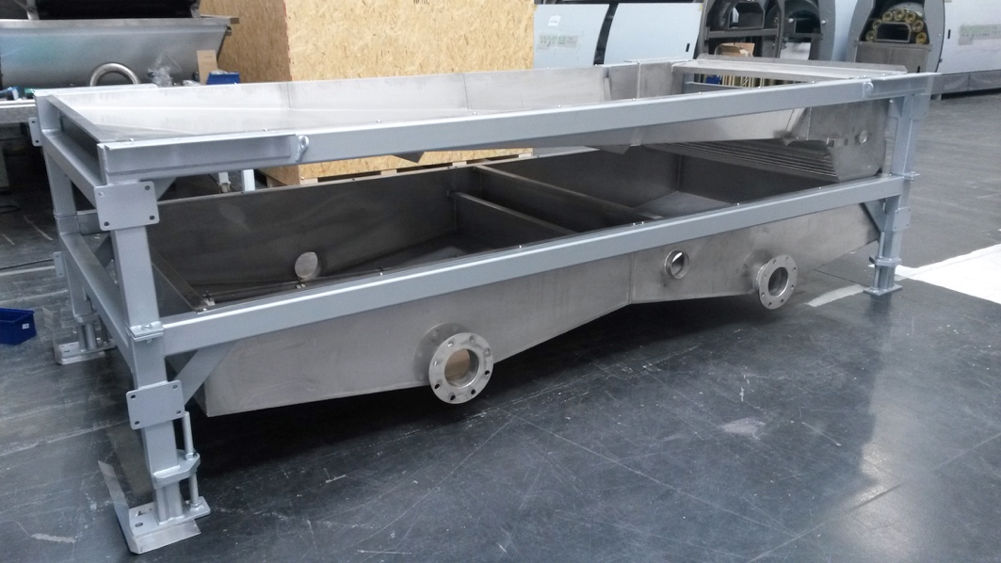
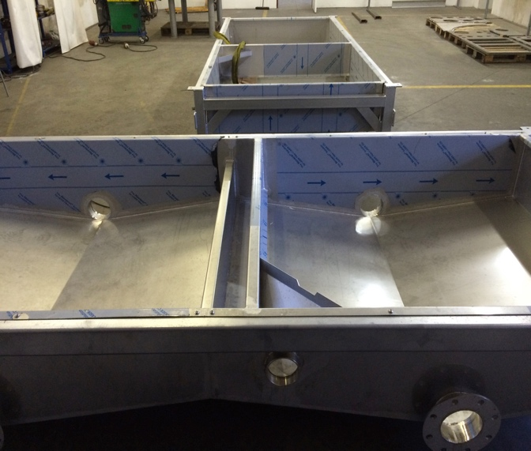
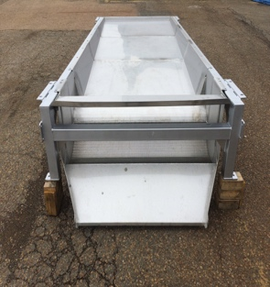
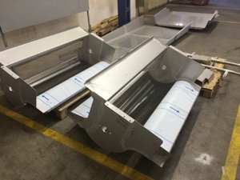
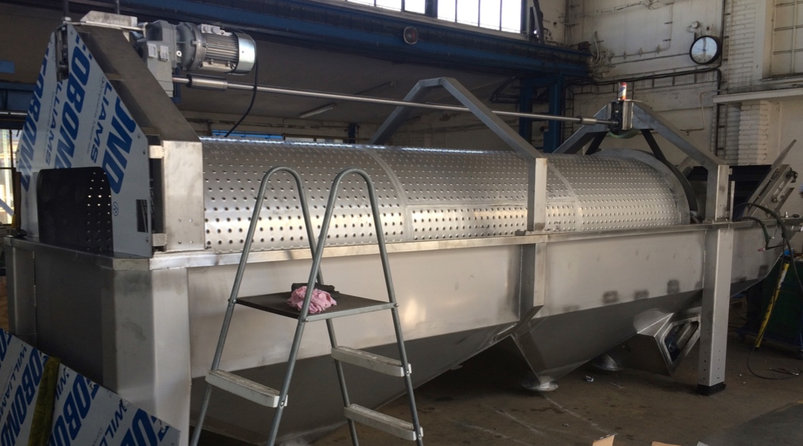
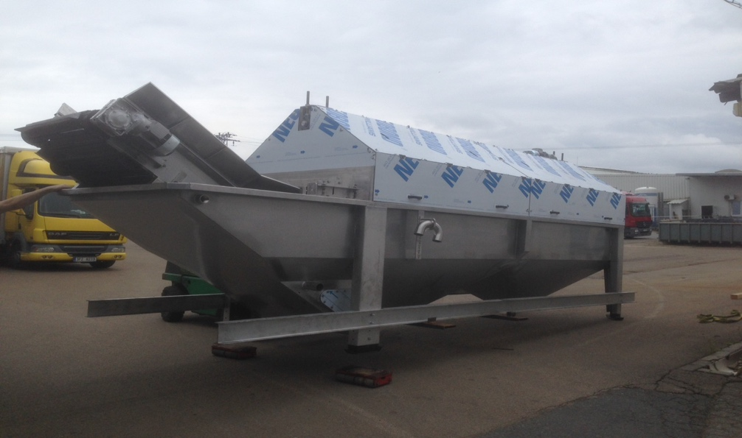
Reference - stainless steel hall

Slide 13
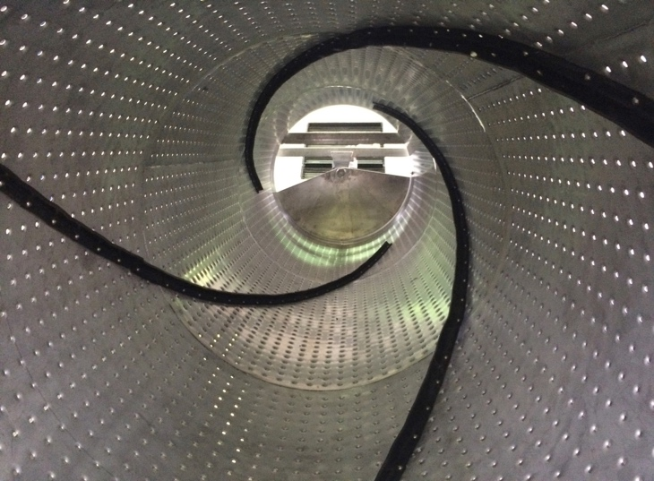
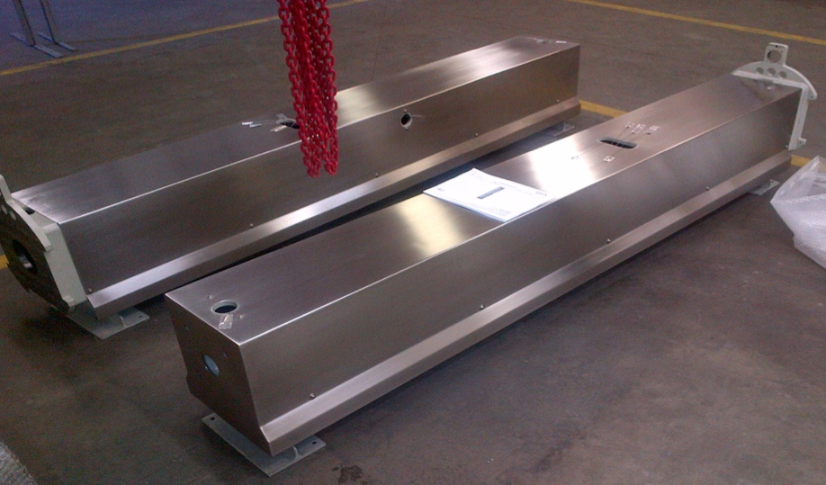
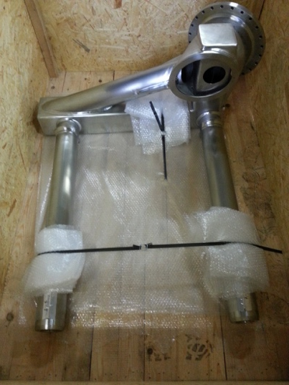
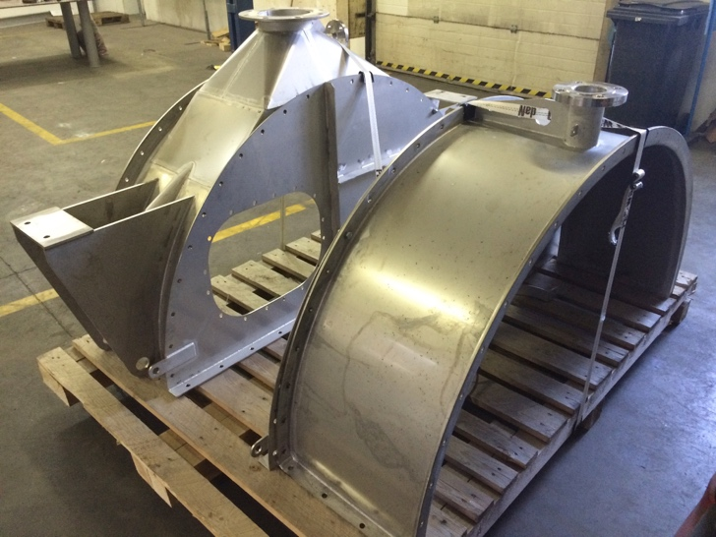
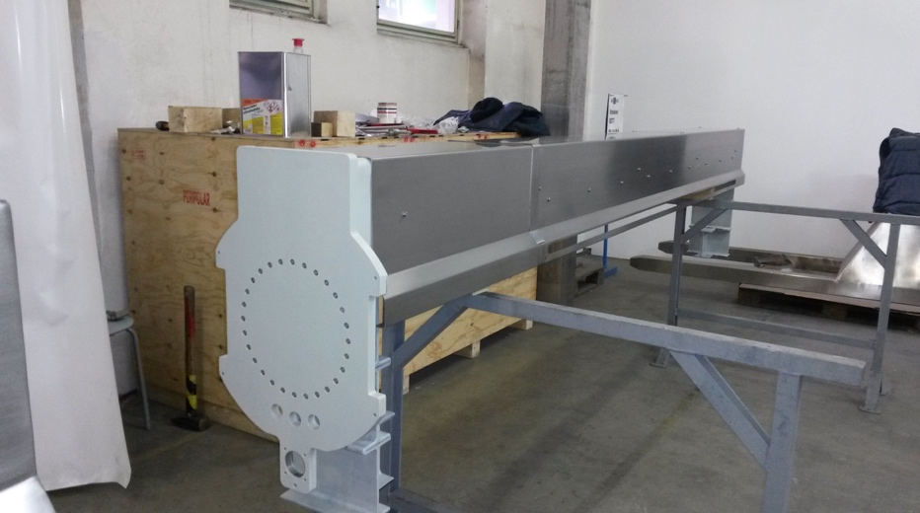
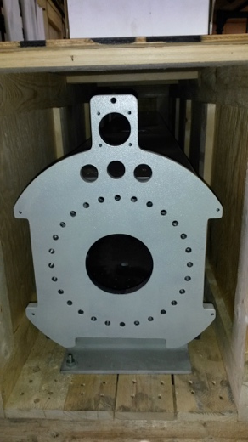
Reference - stainless steel hall

Slide 14
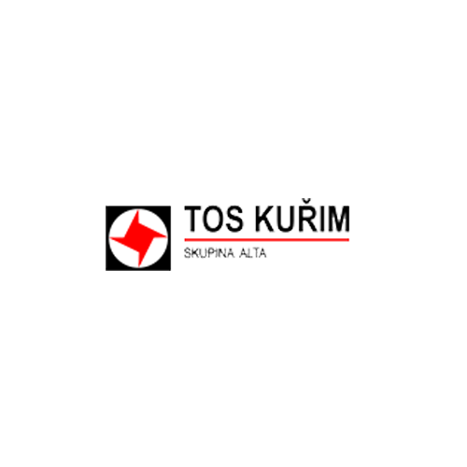
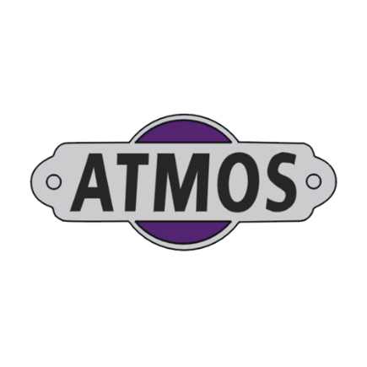
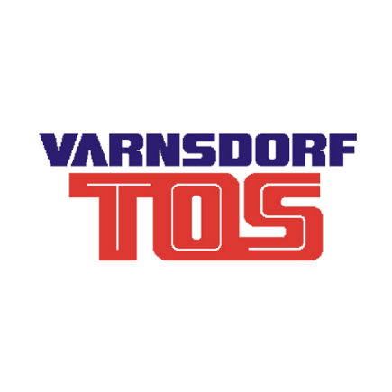
Reference

Slide 15
GPS: 49°43'56.436"N, 13°25.'21.219"E
Modern manufacturing and trading company
Wealth of experience in the field of supplies to the engineering industry
Quality products and services
The company builds on market knowledge and the experience of its employees
SAROND WELDING, s.r.o. Božkovské náměstí 17/21, 326 00 Plzeň
Czech Republic T: +420 377 457 612 Fax: +420 377 457 611 e-mail: info@sarond-welding.cz
www.sarond.cz, www.sarond-welding.cz
Bronislav Czyz – Managing Director
Email: bronislav.czyz@sarond.cz

